Slide 1

Global Warming;
The demand for a shift to sustainable energy, and this is why...

Slide 2


Slide 3


Slide 4


Slide 5
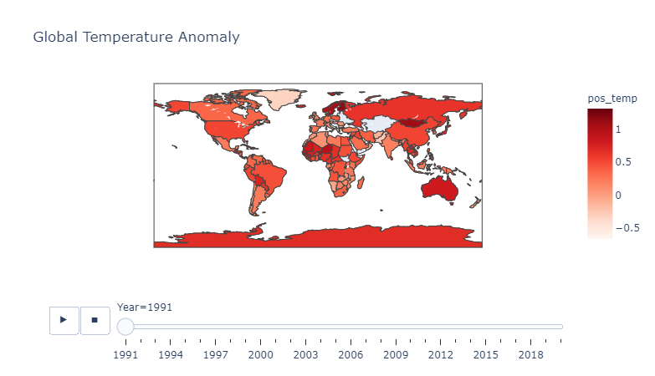

Slide 6
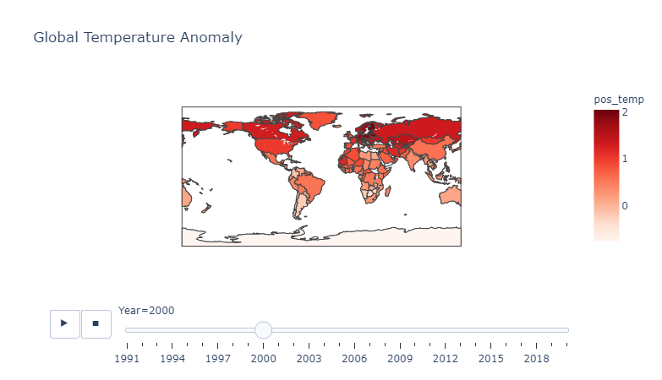

Slide 7
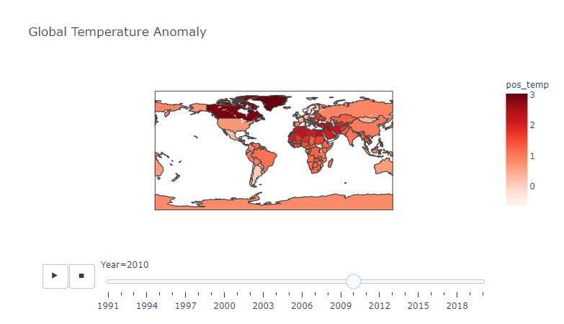

Slide 8
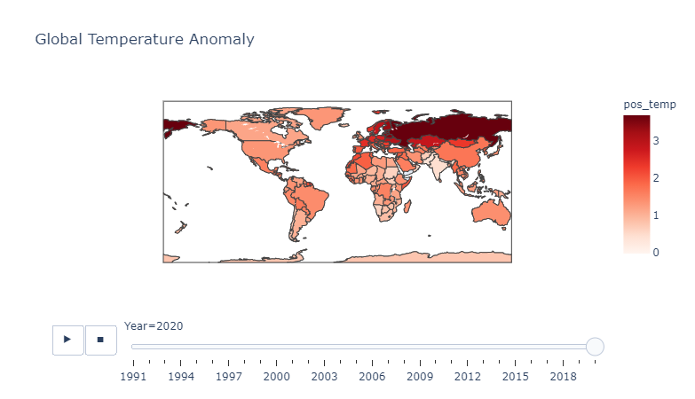

Slide 9
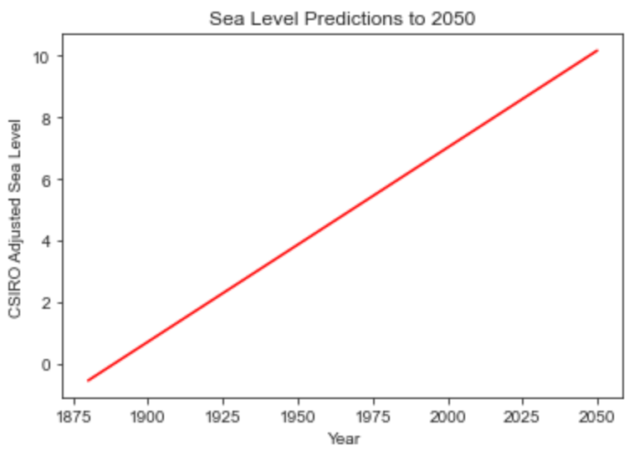
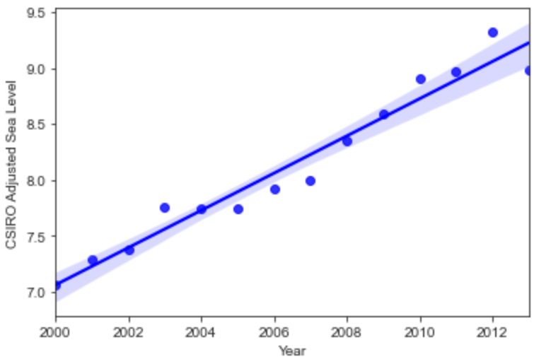
Actual water levels (Blue) vs Predicted (Red)
Real water levels at 5% confidence

Slide 10
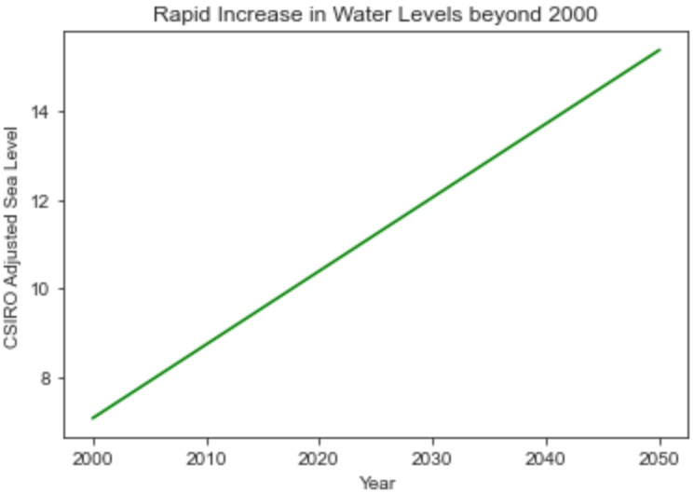
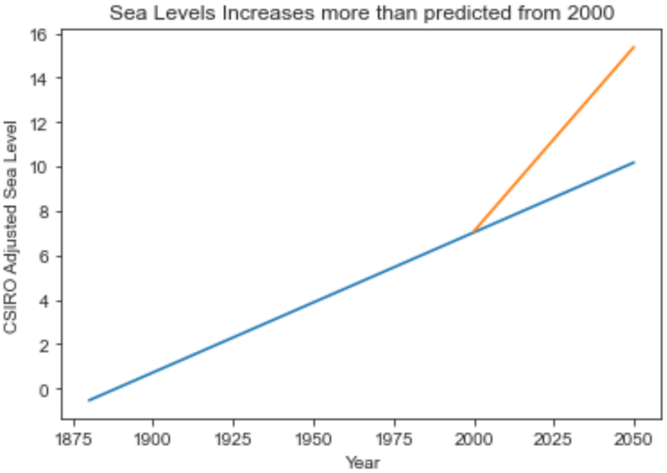
The LinRegressor Model was used to predict the sea level from 2000 - 2050.
Sharper increase than predicted (Green), Original prediction of sea levels (Blue), New predictions due to increase global temperature (Orange = Green)

Slide 11
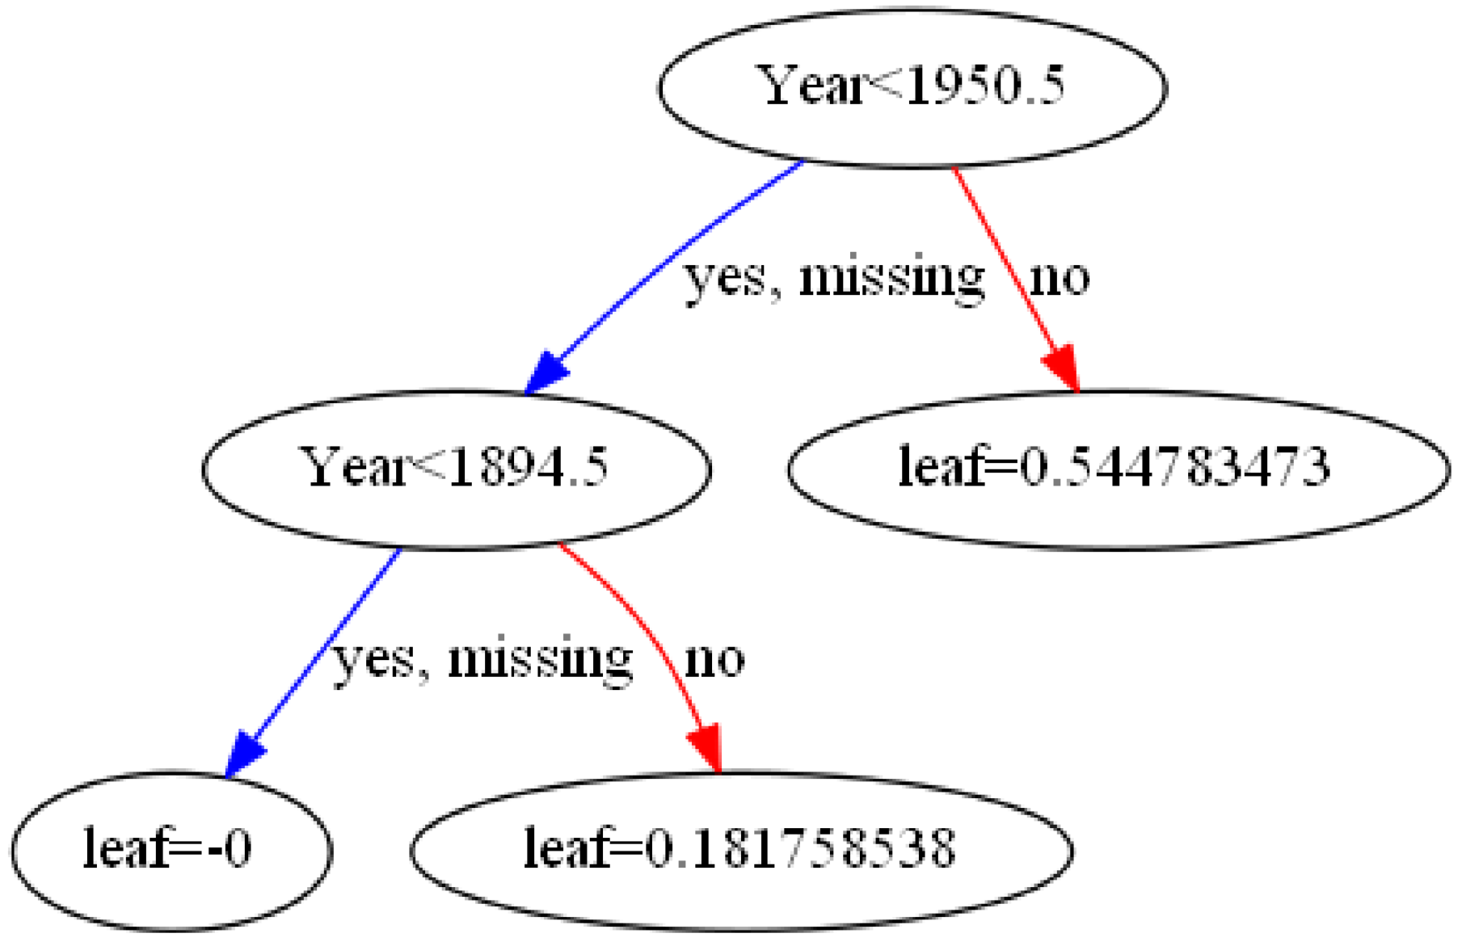
XGBoost Model
Boosting Trees
Notes:
In order to build more robust models, it is common to do a k-fold cross validation where all the entries in the original training dataset are used for both training as well as validation. Also each entry is used for validation just once. Following that, a hyper-parameter dictionary params which holds all the hyper-parameters and their values as key-value pairs were generated.

Slide 12
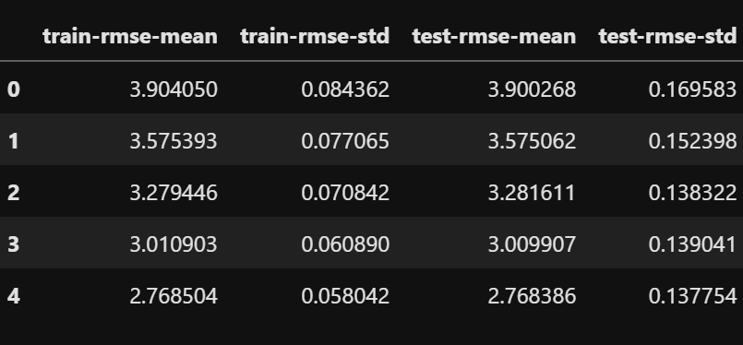
CV Results containing train and test RMSE metrics for each boosting round

Slide 13
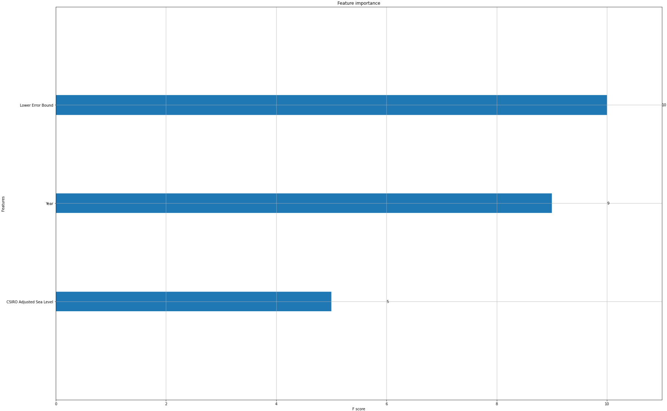
XGBoost Model: Feature Importance
F-score: Lower error Bound (10), Year (9) CSIRO Adjusted Sea Level (5)

Slide 14
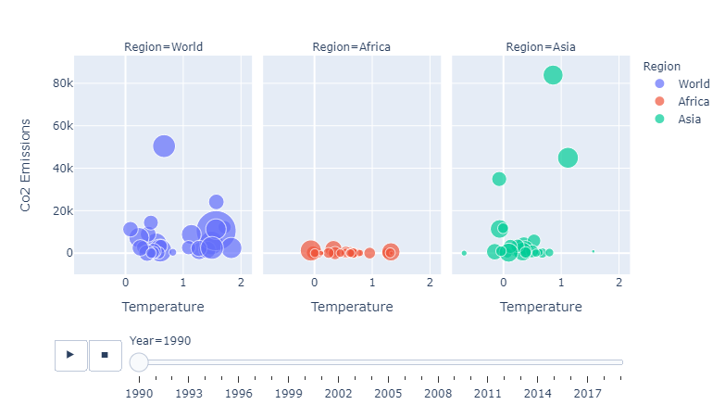
Relationship Between CO2 Emissions, Temperature Change and Crop Yield

Slide 15
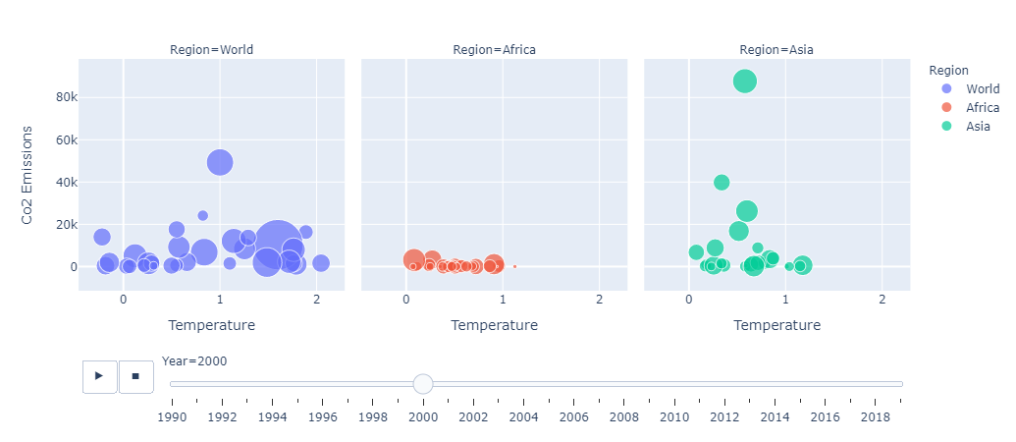
Relationship Between CO2 Emissions, Temperature Change and Crop Yield

Slide 16
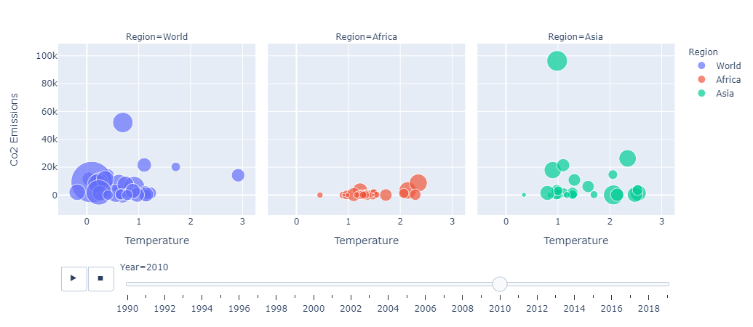
Relationship Between CO2 Emissions, Temperature Change and Crop Yield

Slide 17
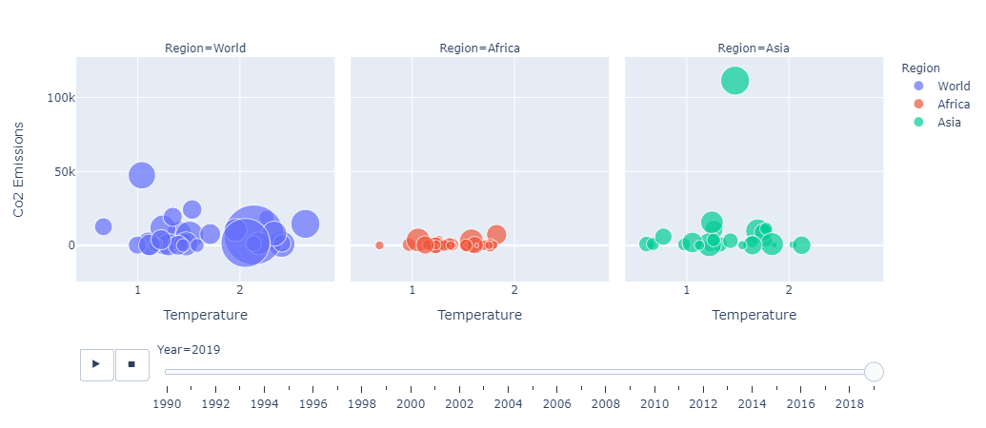
Relationship Between CO2 Emissions, Temperature Change and Crop Yield

Slide 18
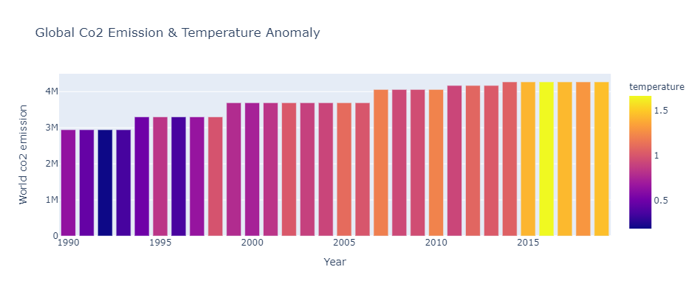

Slide 19
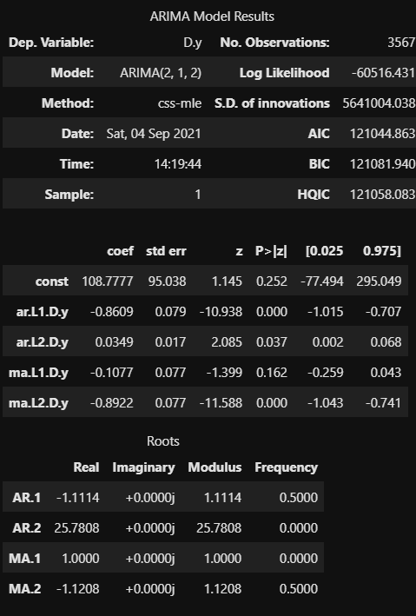
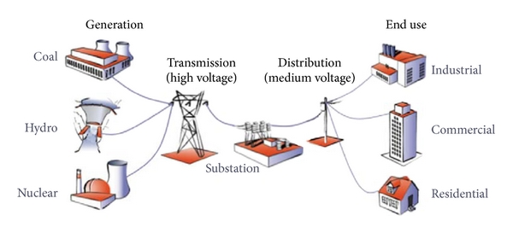
Energy Distribution

Slide 20
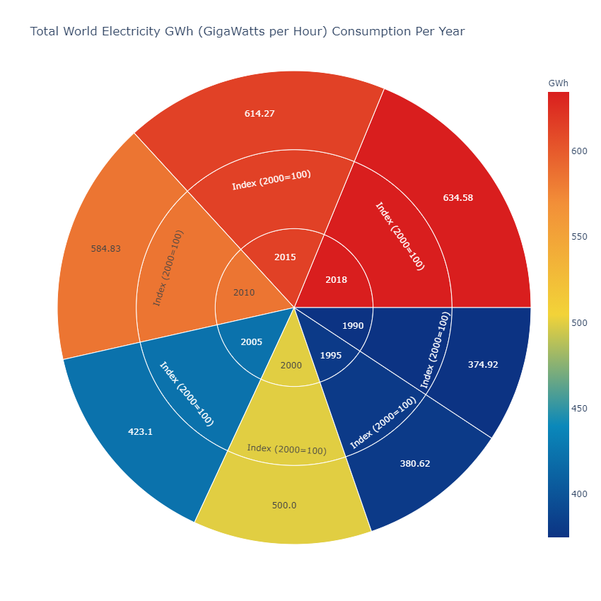
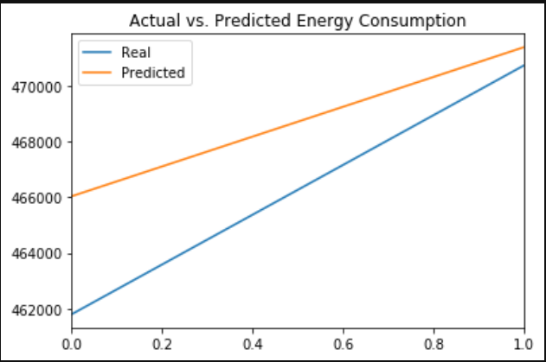
The Arima Model was used to predict Energy consumption

Slide 21
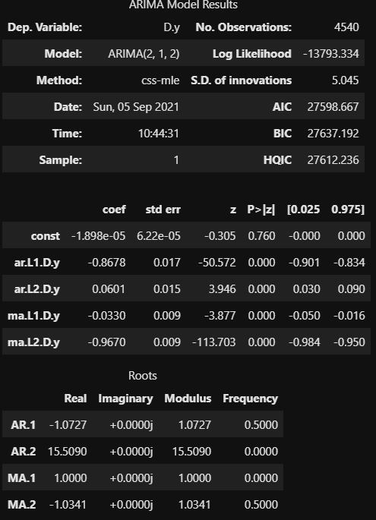
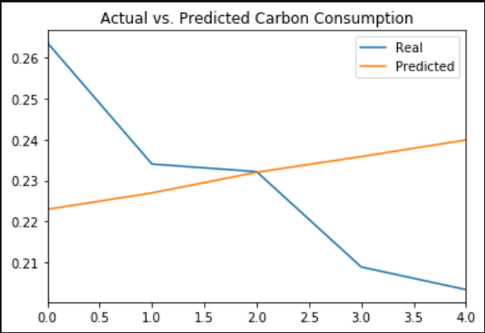
Arima Model showing the consumption of Carbon Globally.

Slide 22
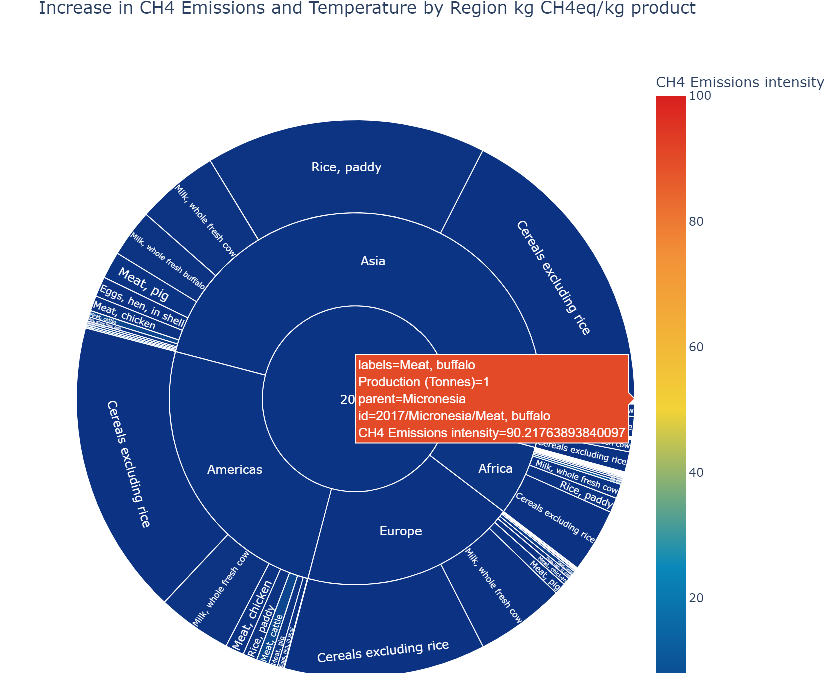
Micronesia is also one of the highest Methane producing countries as of 2017 due to the animal agricultural industry.

Slide 23
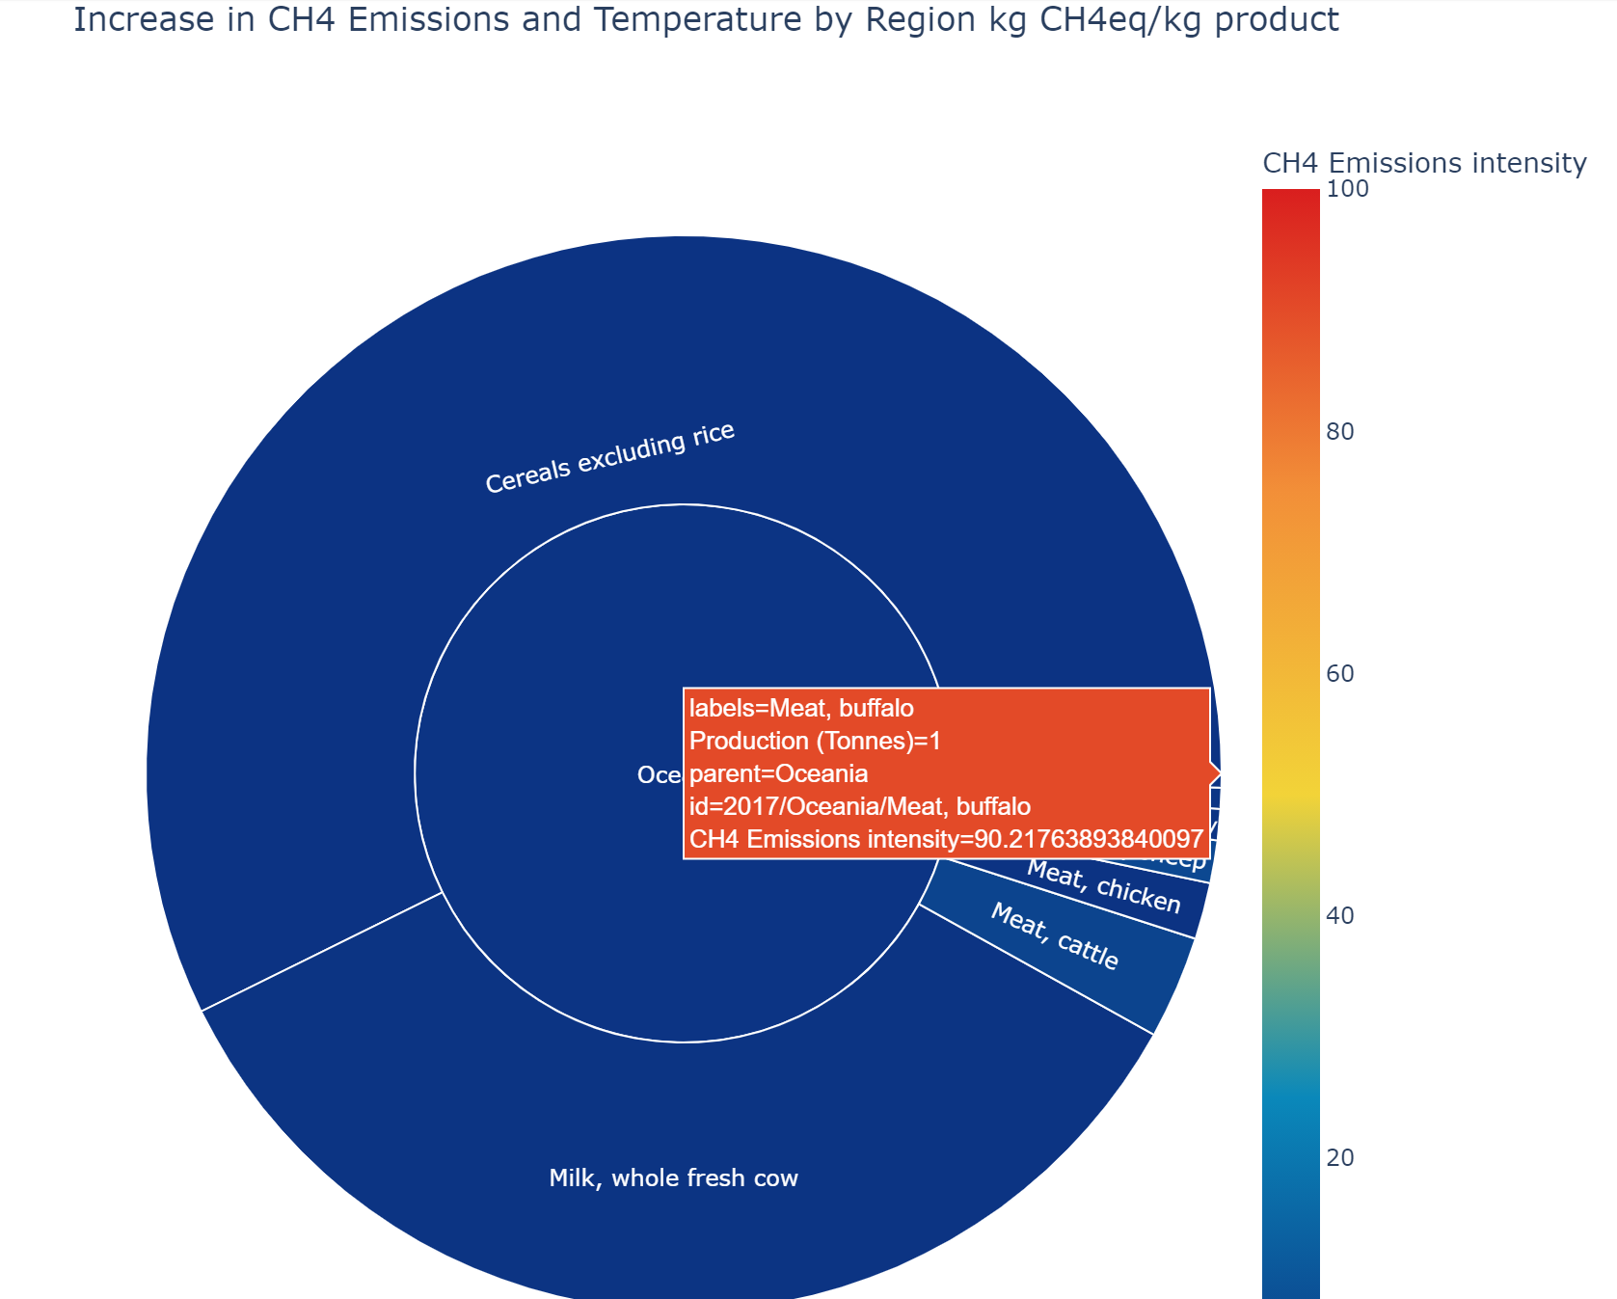
The Oceania Region has the highest measured Methane Emissions Globally. This is due to the high number of cattle.

Slide 24
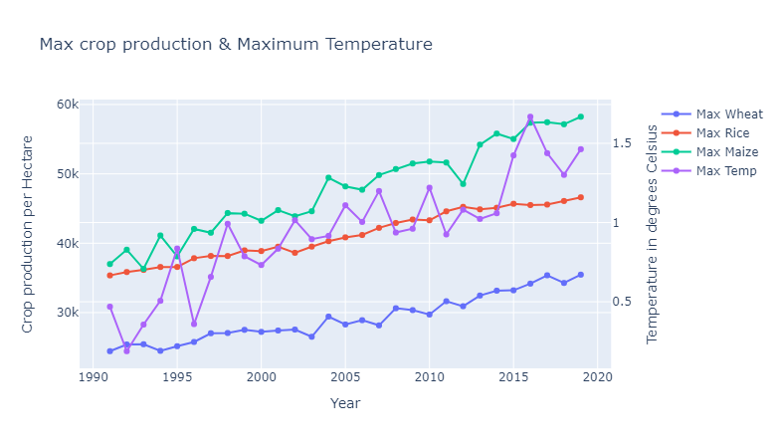
Advancements in Agriculture: has ensured the production of the planets staples despite the increasing temperatures.

Slide 25
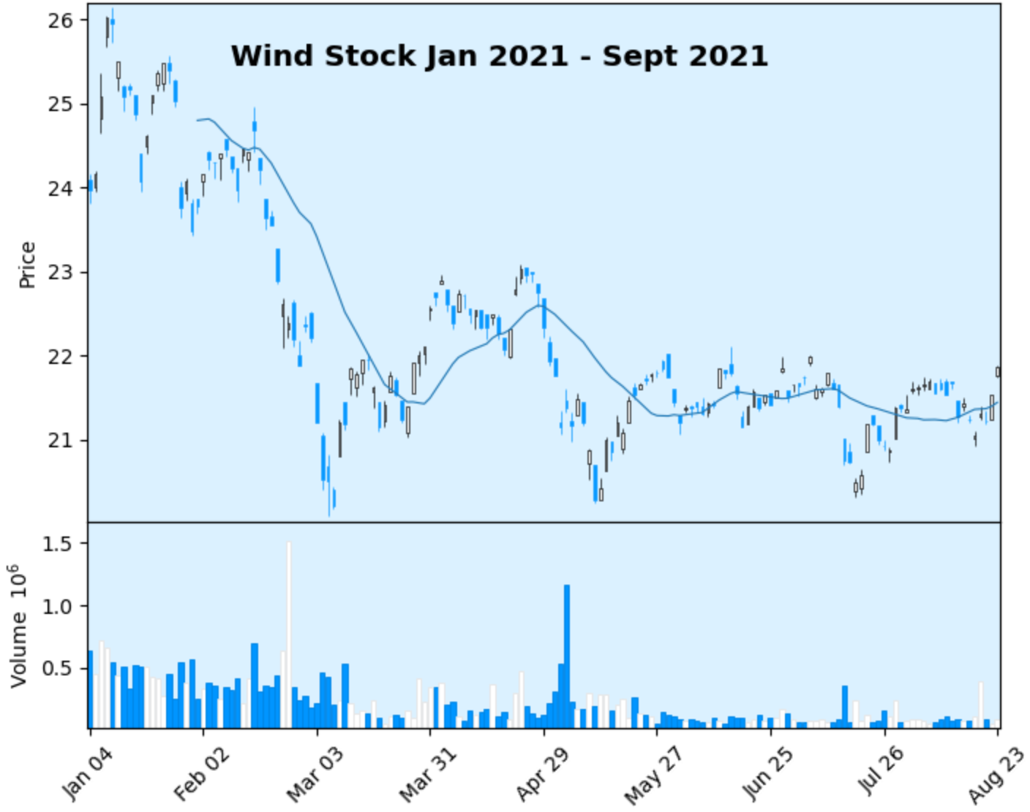
Daily Returns for Wind Stocks, showing little confidence in N.E.Ts

Slide 26
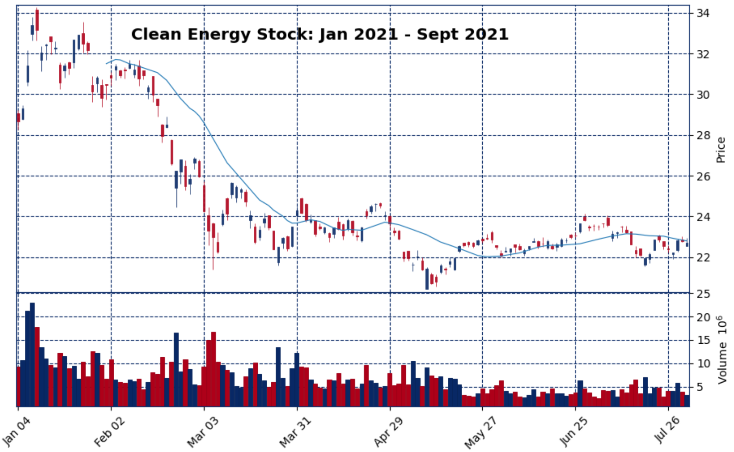
Daily Returns for a Clean Energy Stock, showing little confidence in E.T.Fs

Slide 27
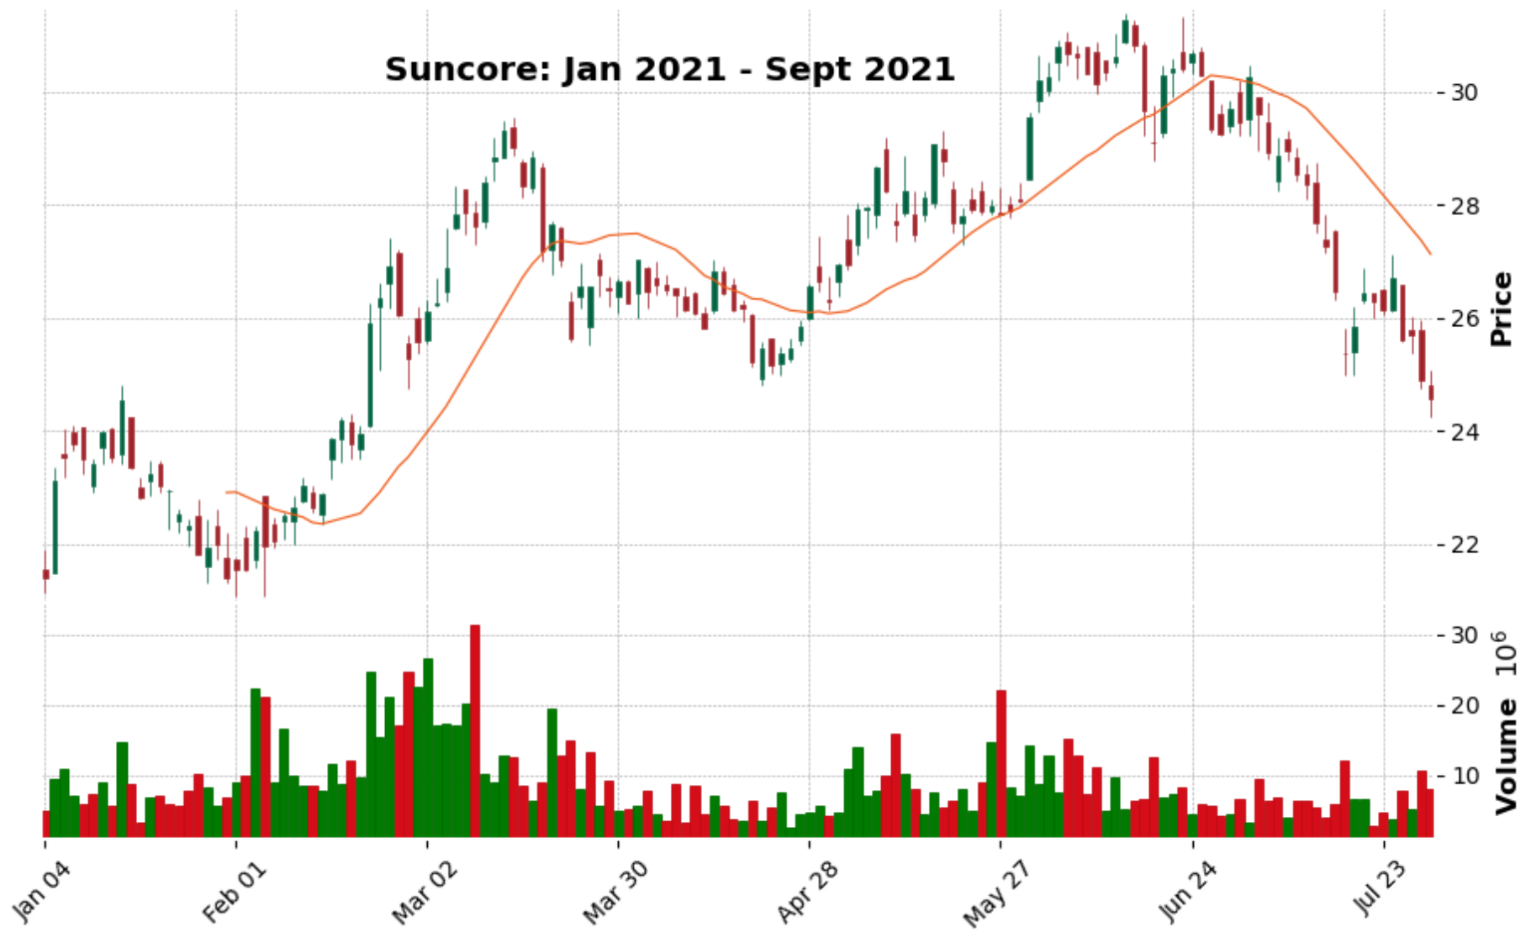
Daily Returns for Suncore Stocks, showing little confidence in N.E.Ts

Slide 28
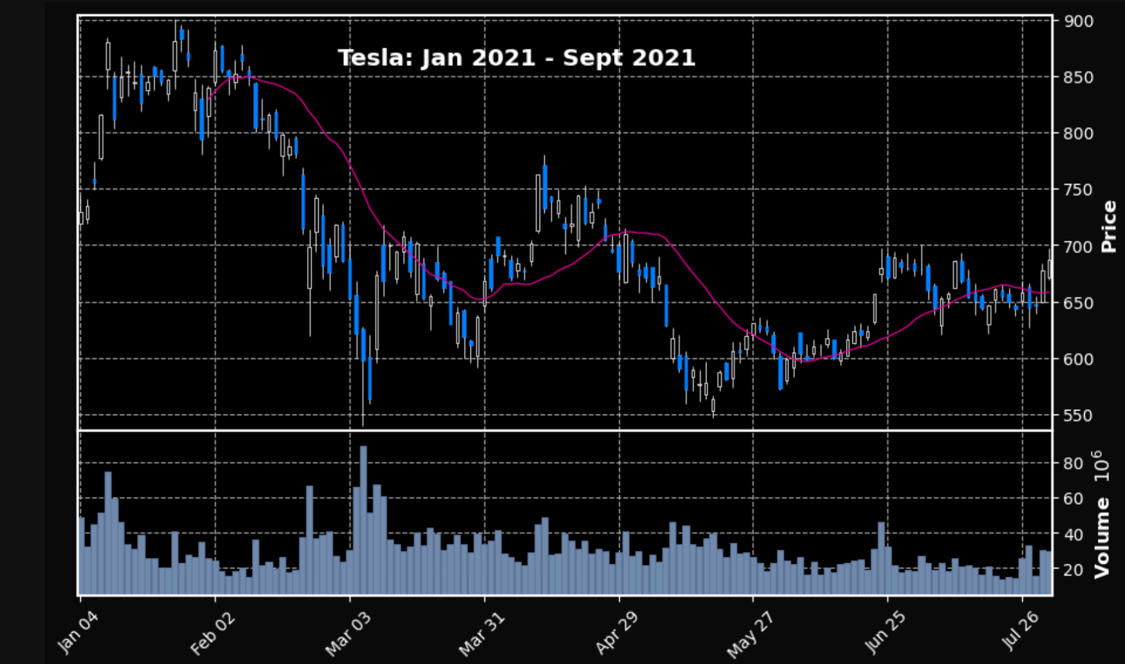
Daily Returns for Tesla Stock, indicating more confidence in E.T.Fs but for profit

Slide 29
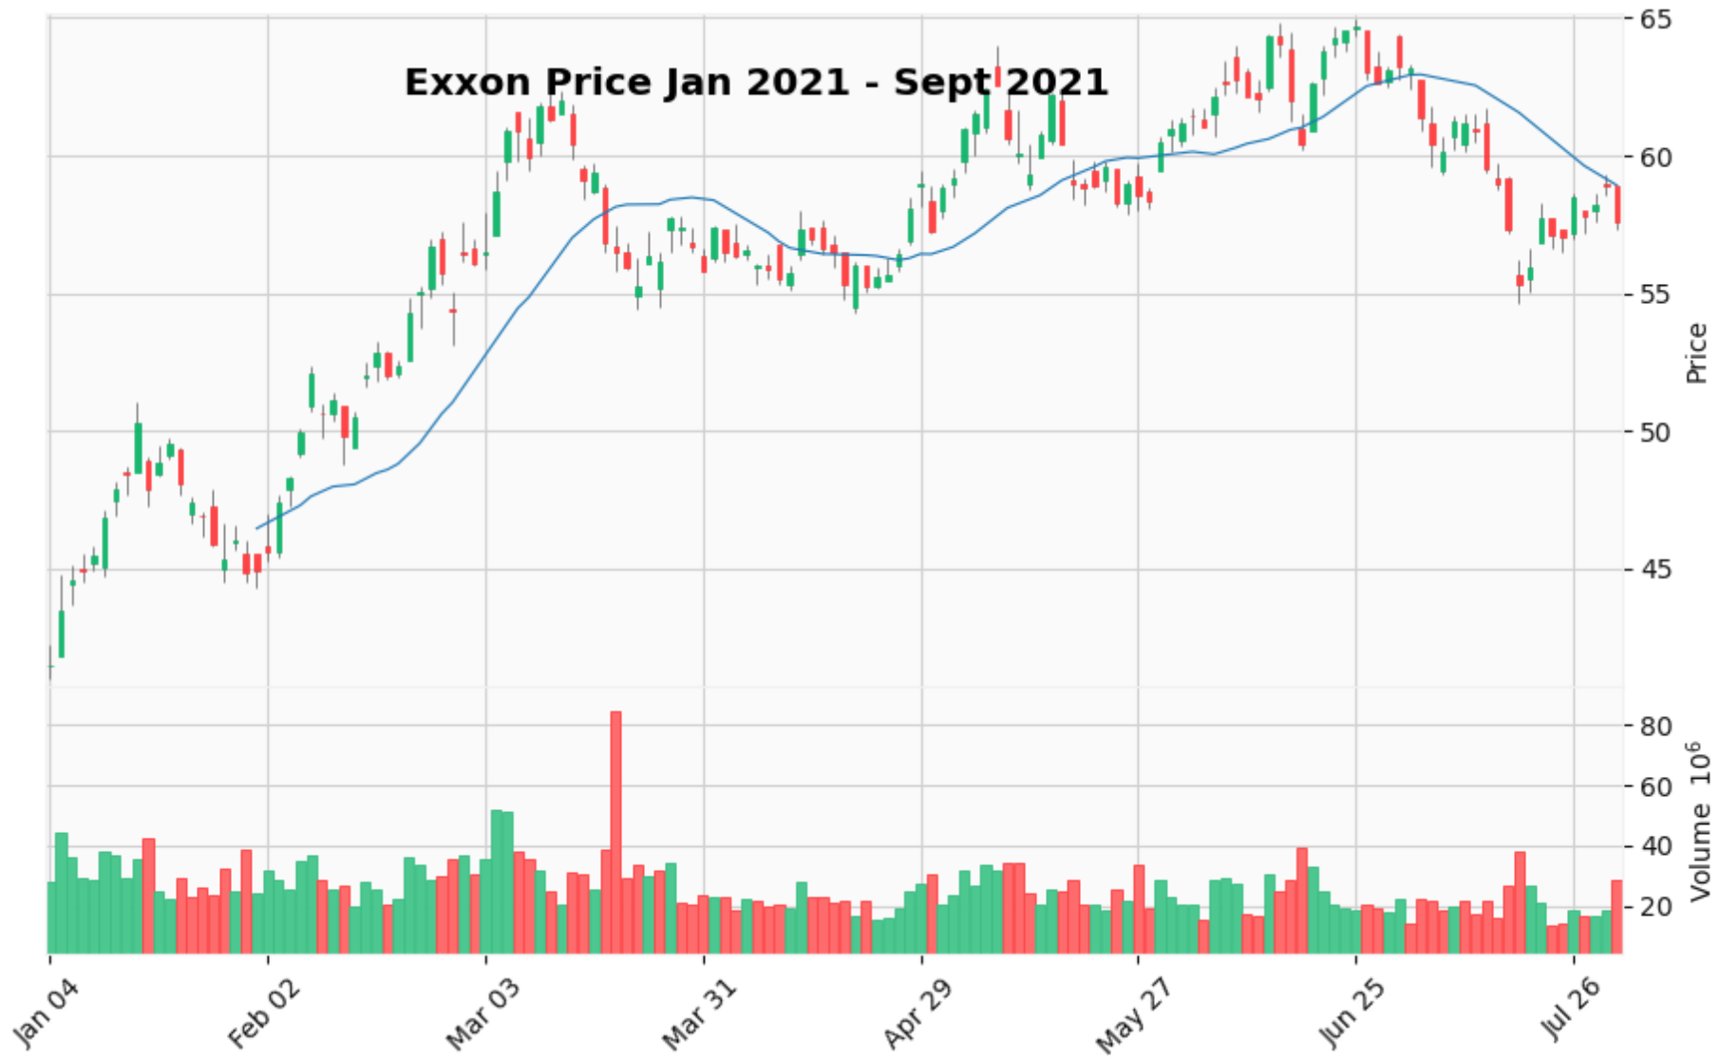
Daily Returns for Exxon Stock, as confidence remains in fossil fuels.

Slide 30
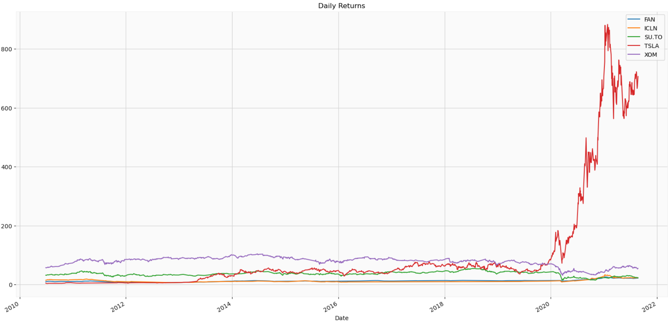
This comparison investment plot indicates a higher return in Exxon stocks than the recommended E.T.Fs

Slide 31

There is Hope!
We will be taking questions after the last video, thank you..

Slide 32


